Slide 1
ATYPICAL TERATOID RHABDOID TUMOR(AT/RTs) CLASSIFICATION USING VGG-19
Presented by :-
TK VAMSHI KRISHNA – 21MIC7023
A.V.S HEMANTH KUMAR – 21MIC7052
A. PRAJWAL SRI TEJ – 21MIC7107

Slide 2
Table of contents
1
6
2
Introduction
7
3
Data sets
8
System Architecture
Results
Image processing
Conclusion
Problem Statement
Data Augmentation
Network Selection
Final Network
4
9
5
10

Slide 3
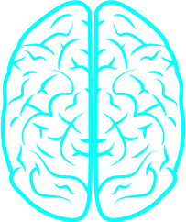
Problem Statement
1
Atypical Teratoid Rhabdoid Tumor (AT/RTs) is a rare and aggressive brain tumor in children aged three to six. This project aims to develop a deep learning model using a Sequential architecture with Visual Geometry Group(VGG-19) to detect and classify AT/RTs from Magnetic resonance imaging (MRI) scans. The model will be trained with the Adam optimizer and involve preprocessing a diverse dataset, utilizing layers like Conv2D and MaxPooling2D, to create a reliable diagnostic tool for pediatrician radiologists.

Slide 4
Introduction/ Motivation
2
ATRT is a rare, Traditional diagnostic methods are slow and invasive.
Advanced Convolutional Neural Network(CNNs), excelling in image recognition, can be trained on MRI scans to accurately detect ATRT, distinguishing it from other brain abnormalities.
This project aims to build a robust CNN model to classify the presence of tumors in brain MRI scans with high accuracy for medical-grade applications.

Slide 5
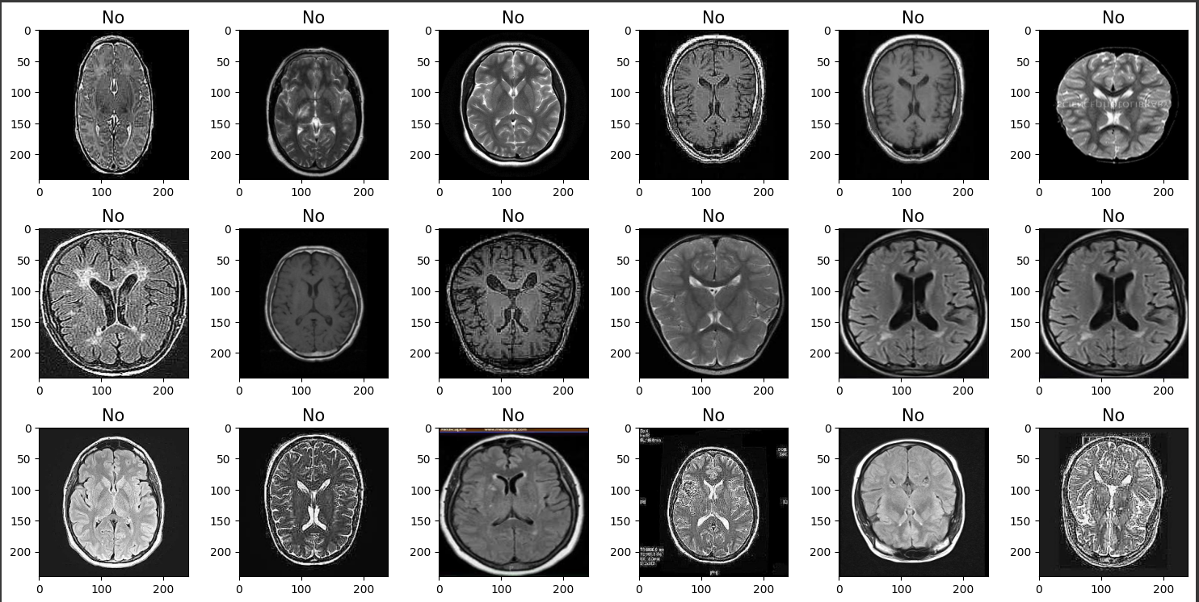
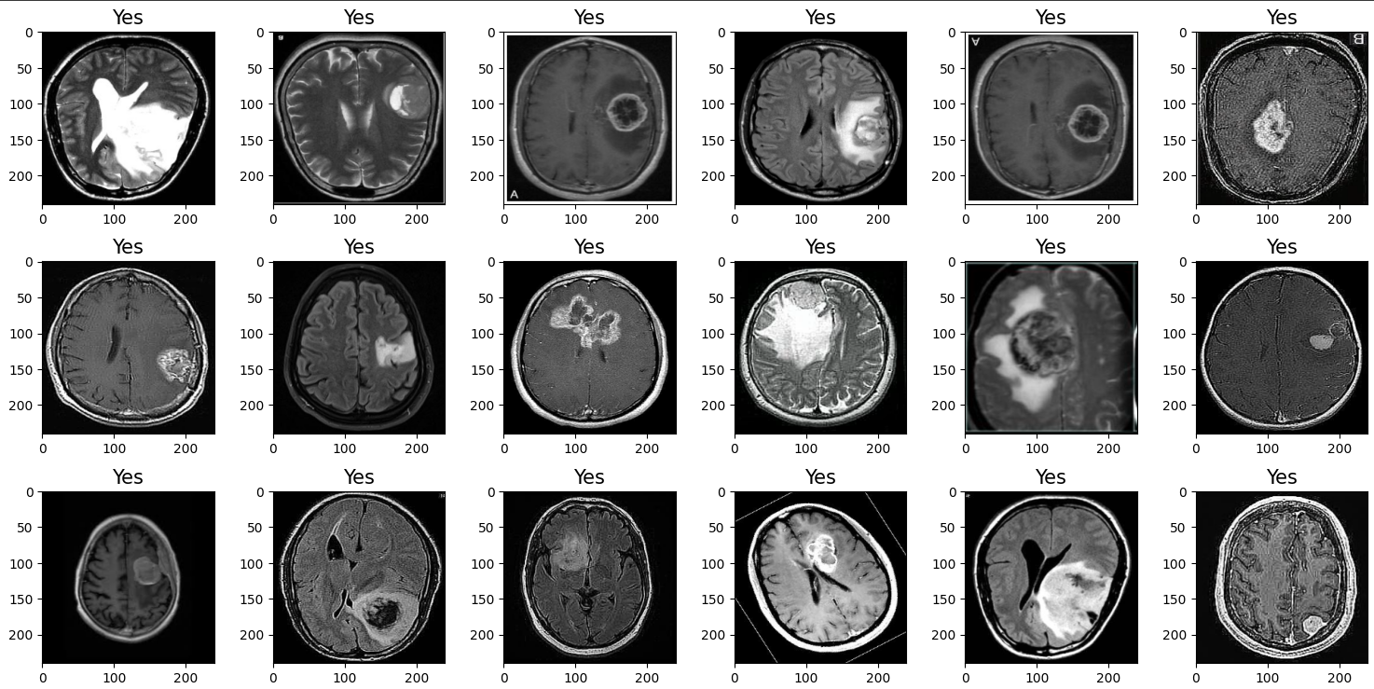
Data Sets
3
Some images from the data sets
Fig 1. Without Tumour (~1499 images)
Fig 2. With Tumour (~1499 images)
These are the data sets we have used:
Br35H:
https://www.kaggle.com/datasets/ahmedhamada0/brain-tumor-detection
RSNA:
https://www.kaggle.com/competitions/rsna-miccai-brain-tumor-radiogenomic-classification/overview

Slide 6
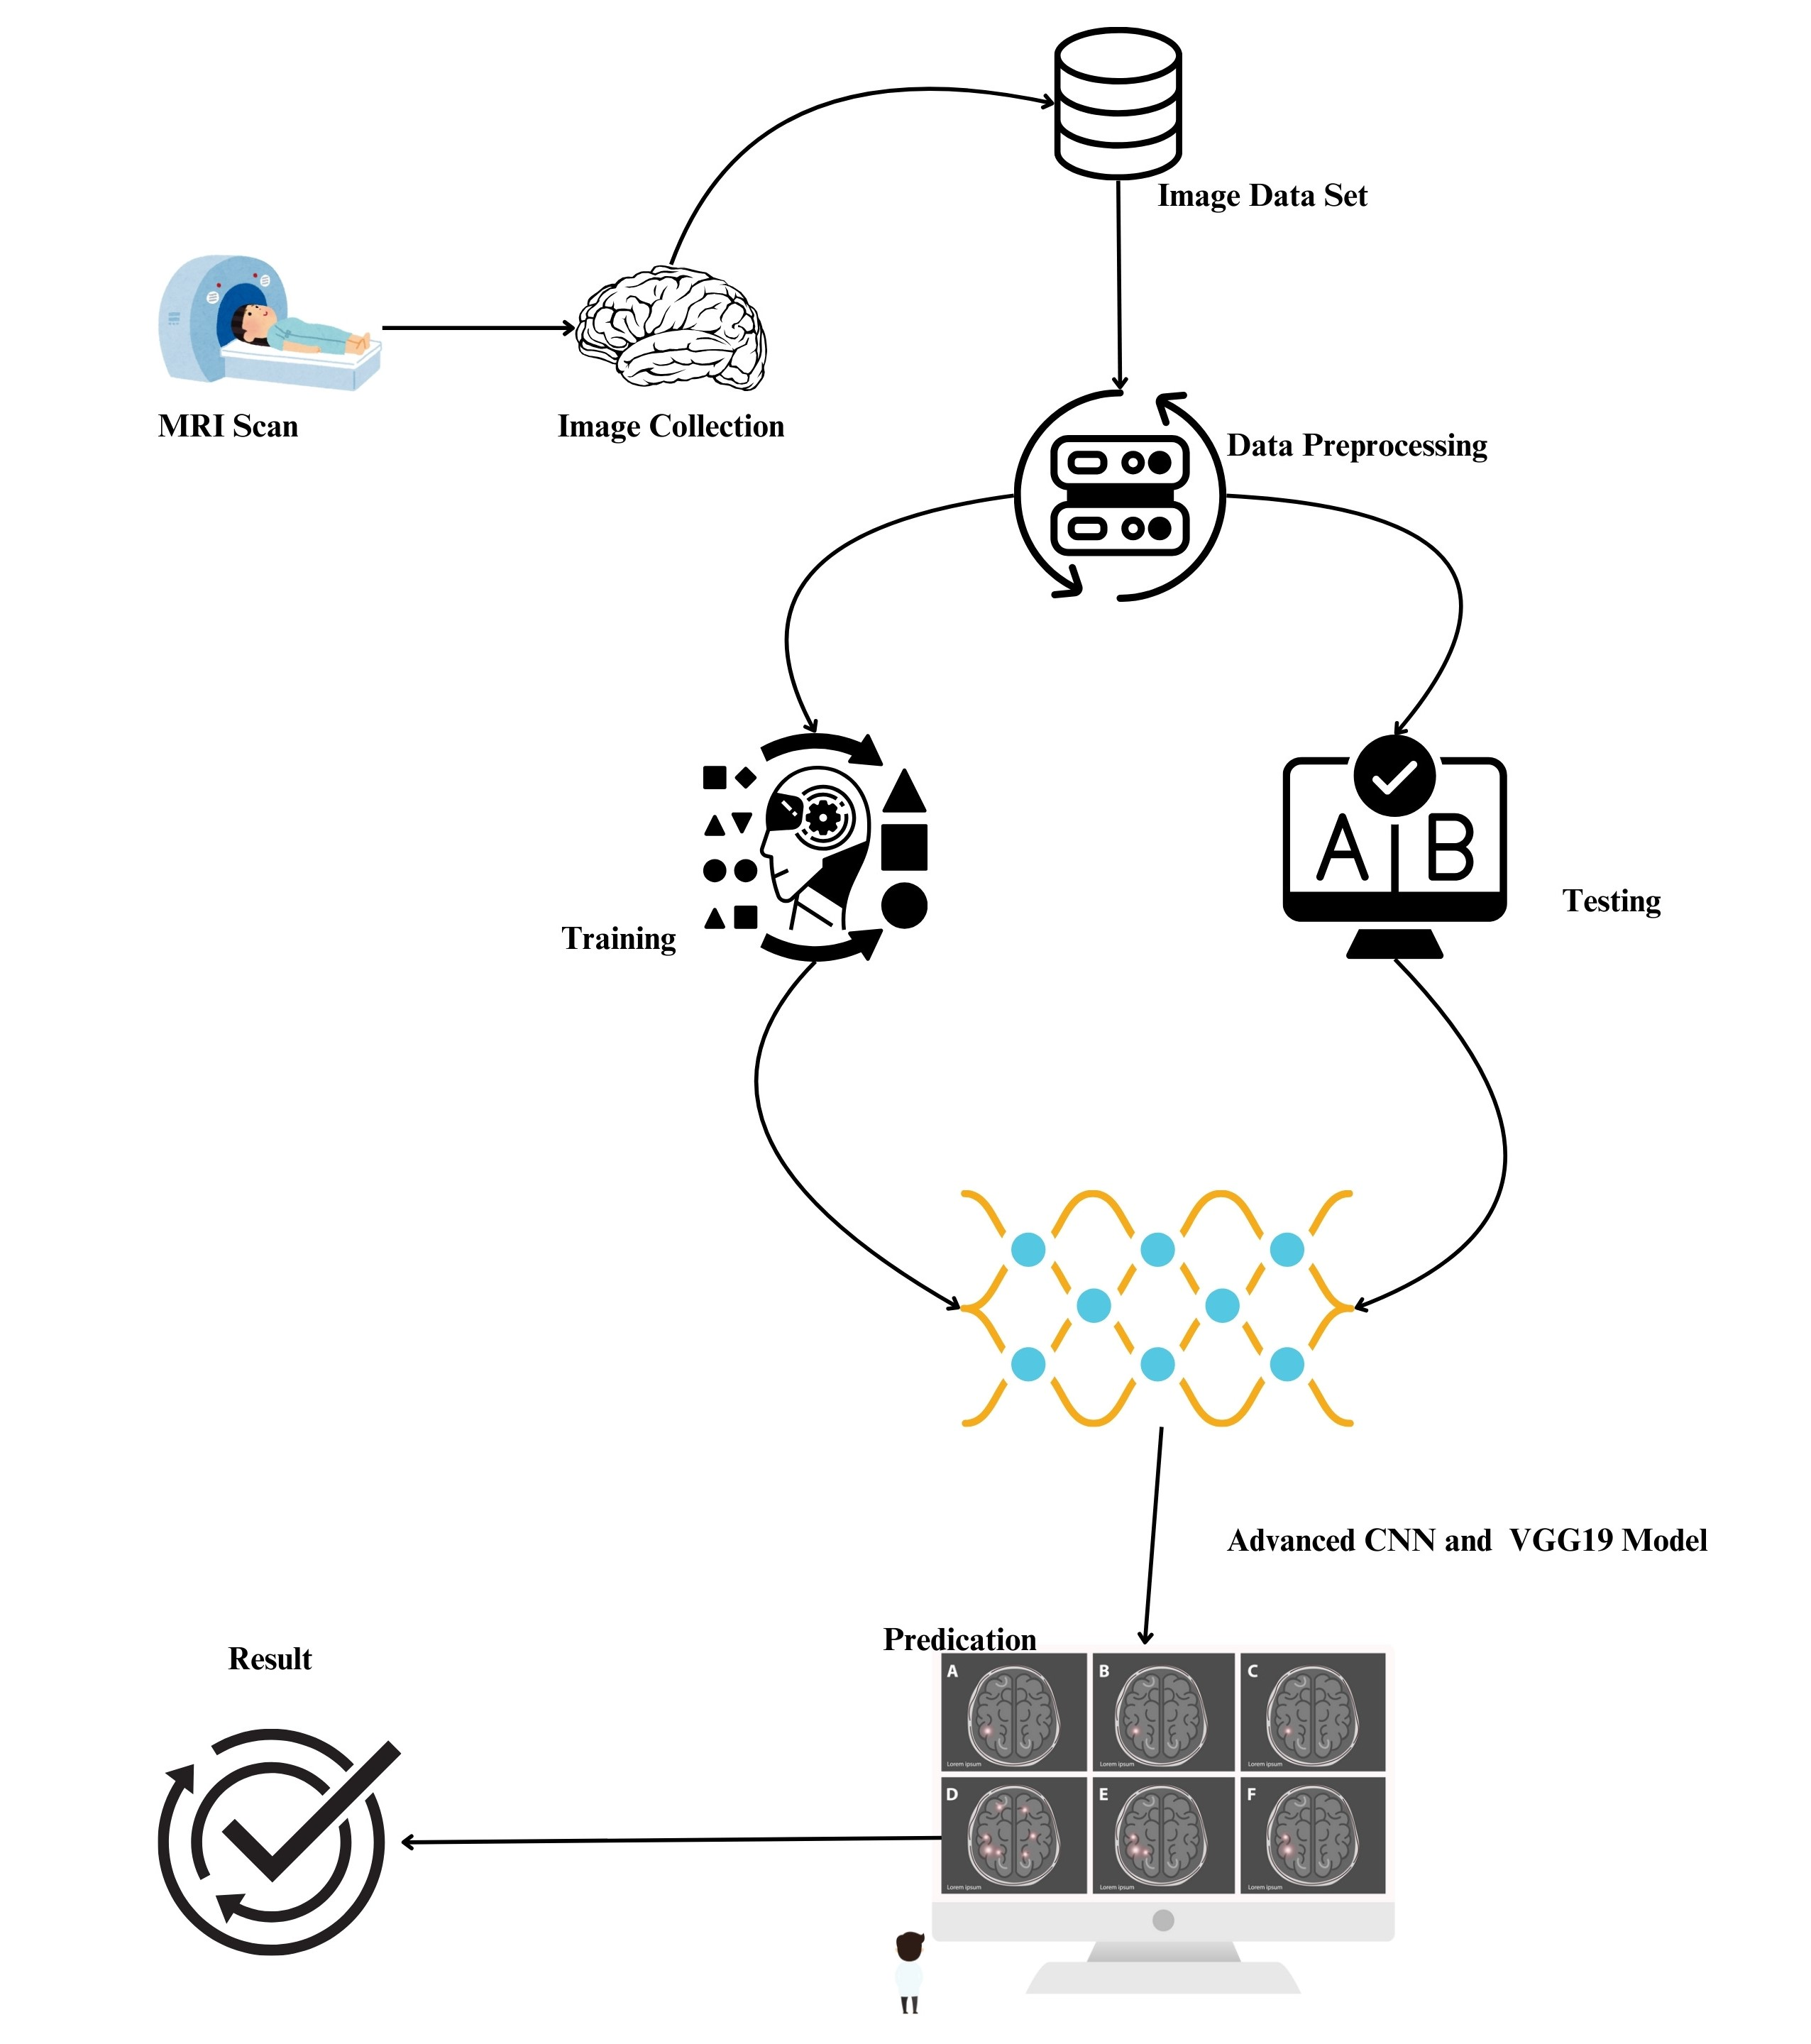
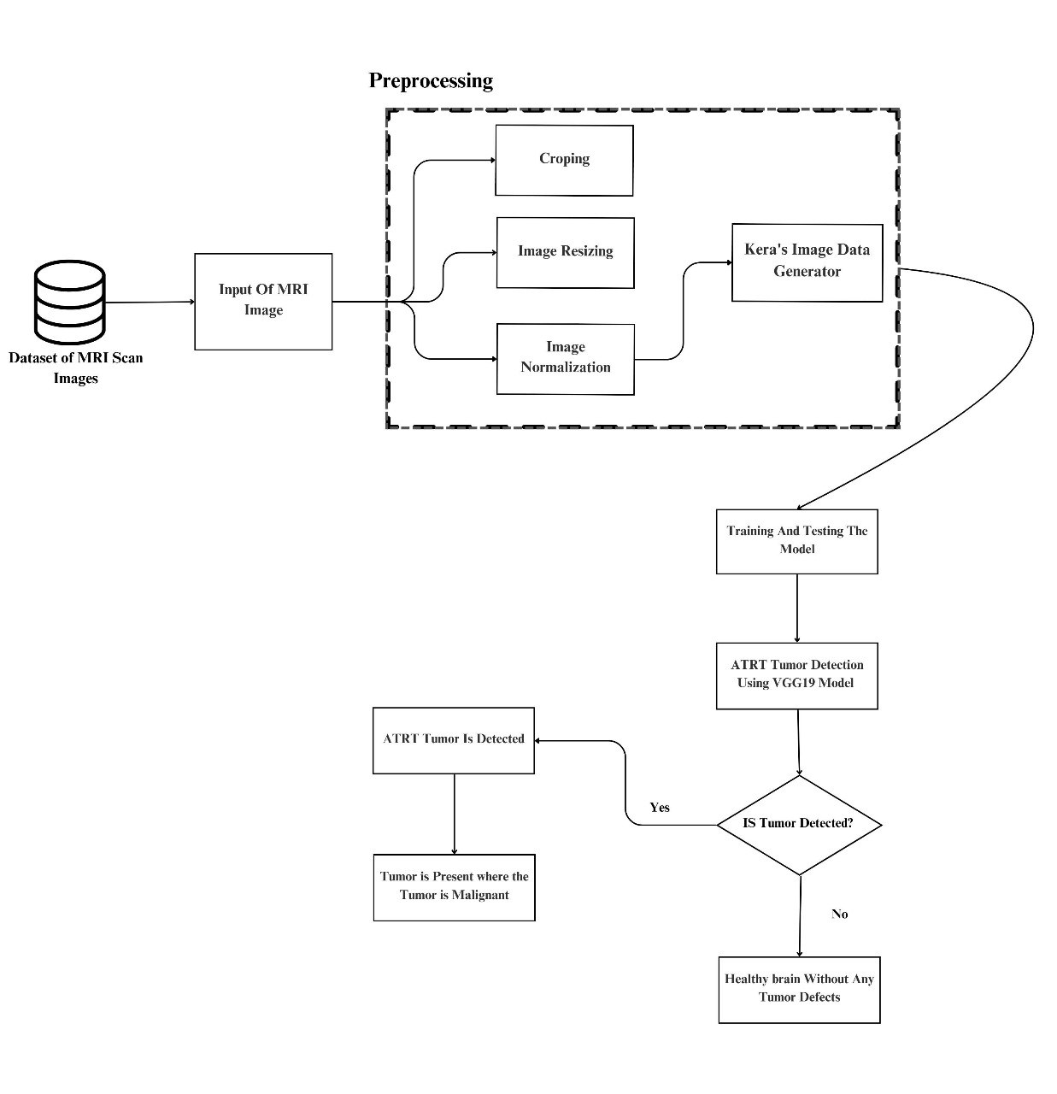
System Architecture
4
Fig 3.
Fig 4.

Slide 7
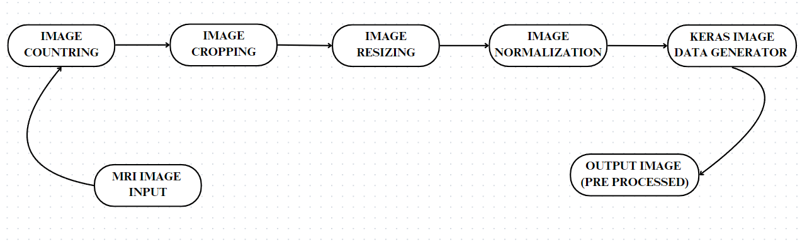
Image Processing
5
Fig.5

Slide 8
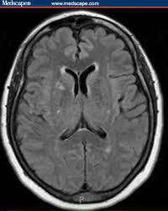
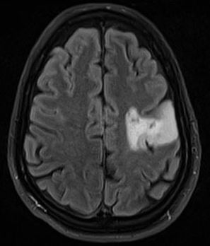
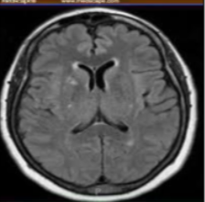
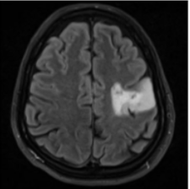
Preprocessing images
5
Fig6. Original images from data set images
Fig7. Normalised images
Without tumour
With tumour
Without tumour
With tumour

Slide 9
Data Augmentation
6
We used the “Keras Image Data Generator” provided by Keras among other techniques for data augmentation.
It replaces the original batch with the new, randomly transformed batch of images.
For augmentation the following operations were applied: rotation_range, width_shift_range, height_shift_range, horizontal_flip, vertical_flip, channel_shift_range, fill_mode, brightness_range.

Slide 10
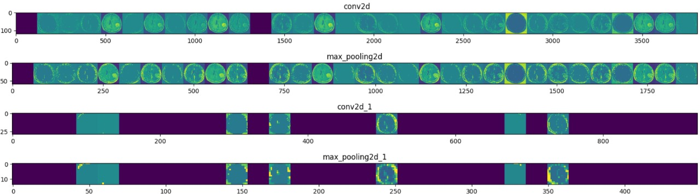
Data Augmentation
6
Fig 8.

Slide 11
Network selection
7
The model aims for high test and validation accuracy.
Utilized various CNNs with parameter tuning, including advanced models with multiple convolution and max-pooling layers.
Improved results using Visual Geometry Group – 19 (VGG19) with a sequential model and Adam optimizer for efficiency and reliability.
Employed layers like Conv2D, MaxPooling2D, ImageNormalization, Flatten, Dense, and Dropout for feature extraction and classification.
Standardized input size to 240x240 pixels for compatibility with VGG-19, maintaining high detail for precise tumor detection.

Slide 12
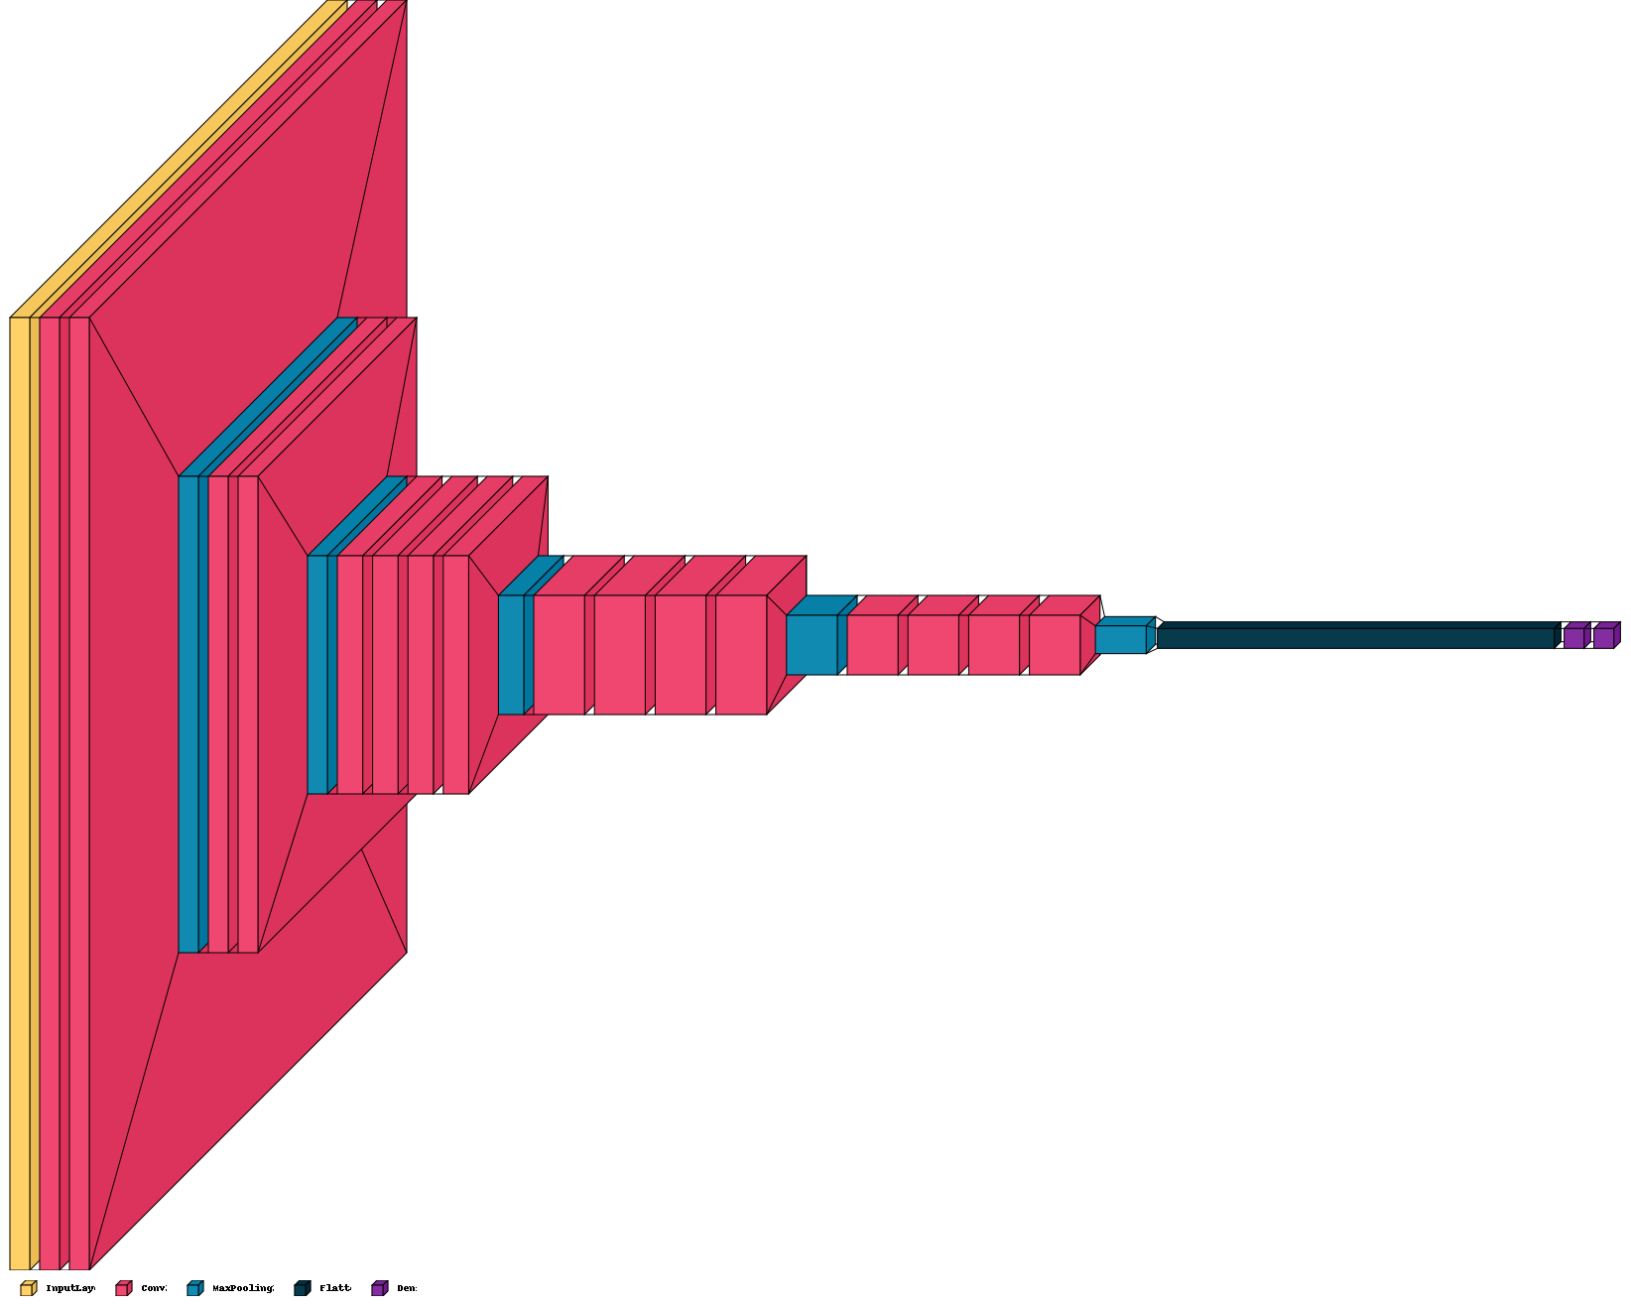
Final Network
8
We found that VGG19 gave best results for the chosen parameters (Training, Validation accuracy
and Test accuracy).
Fig 9.
Input layer
Conv
MaxPooling
Flatten
Dense

Slide 13
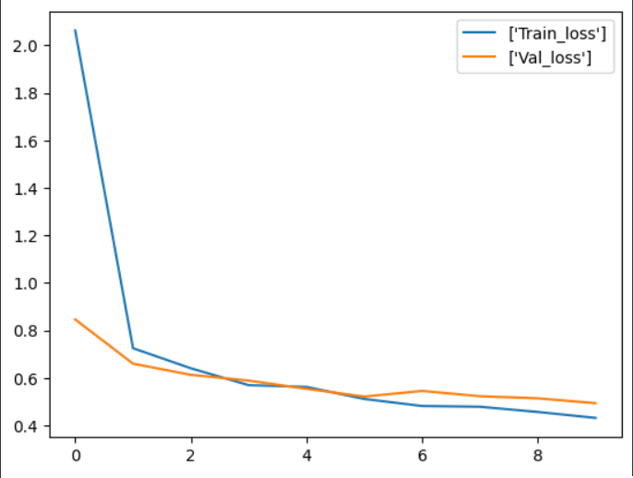
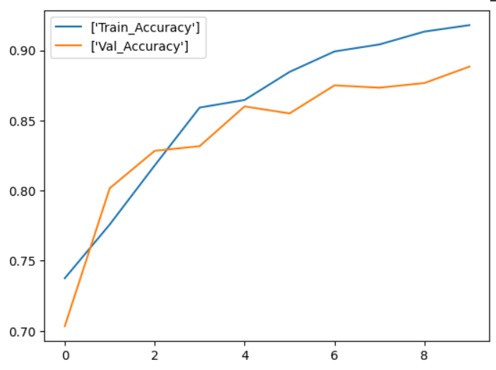
Results
Fig10.Model Loss
9
The VGG-19 model accuracy is approx. 92%
MODEL | CNN | VGG19
TRAINING ACCURACY | 0.85 | 0.92
VALIDATION ACCURAY | 0.78 | 0.89
STABLE | NO | YES
TEST ACCURACY | 0.75 | 0.87
LAYERS MODELS | CONV2D DENSE DROPOUT MAXPOOLING2D | CONV2D DENSE DROPOUT FLATTEN MAXPOOLING2D
Fig11. Model Accuracy

Slide 14
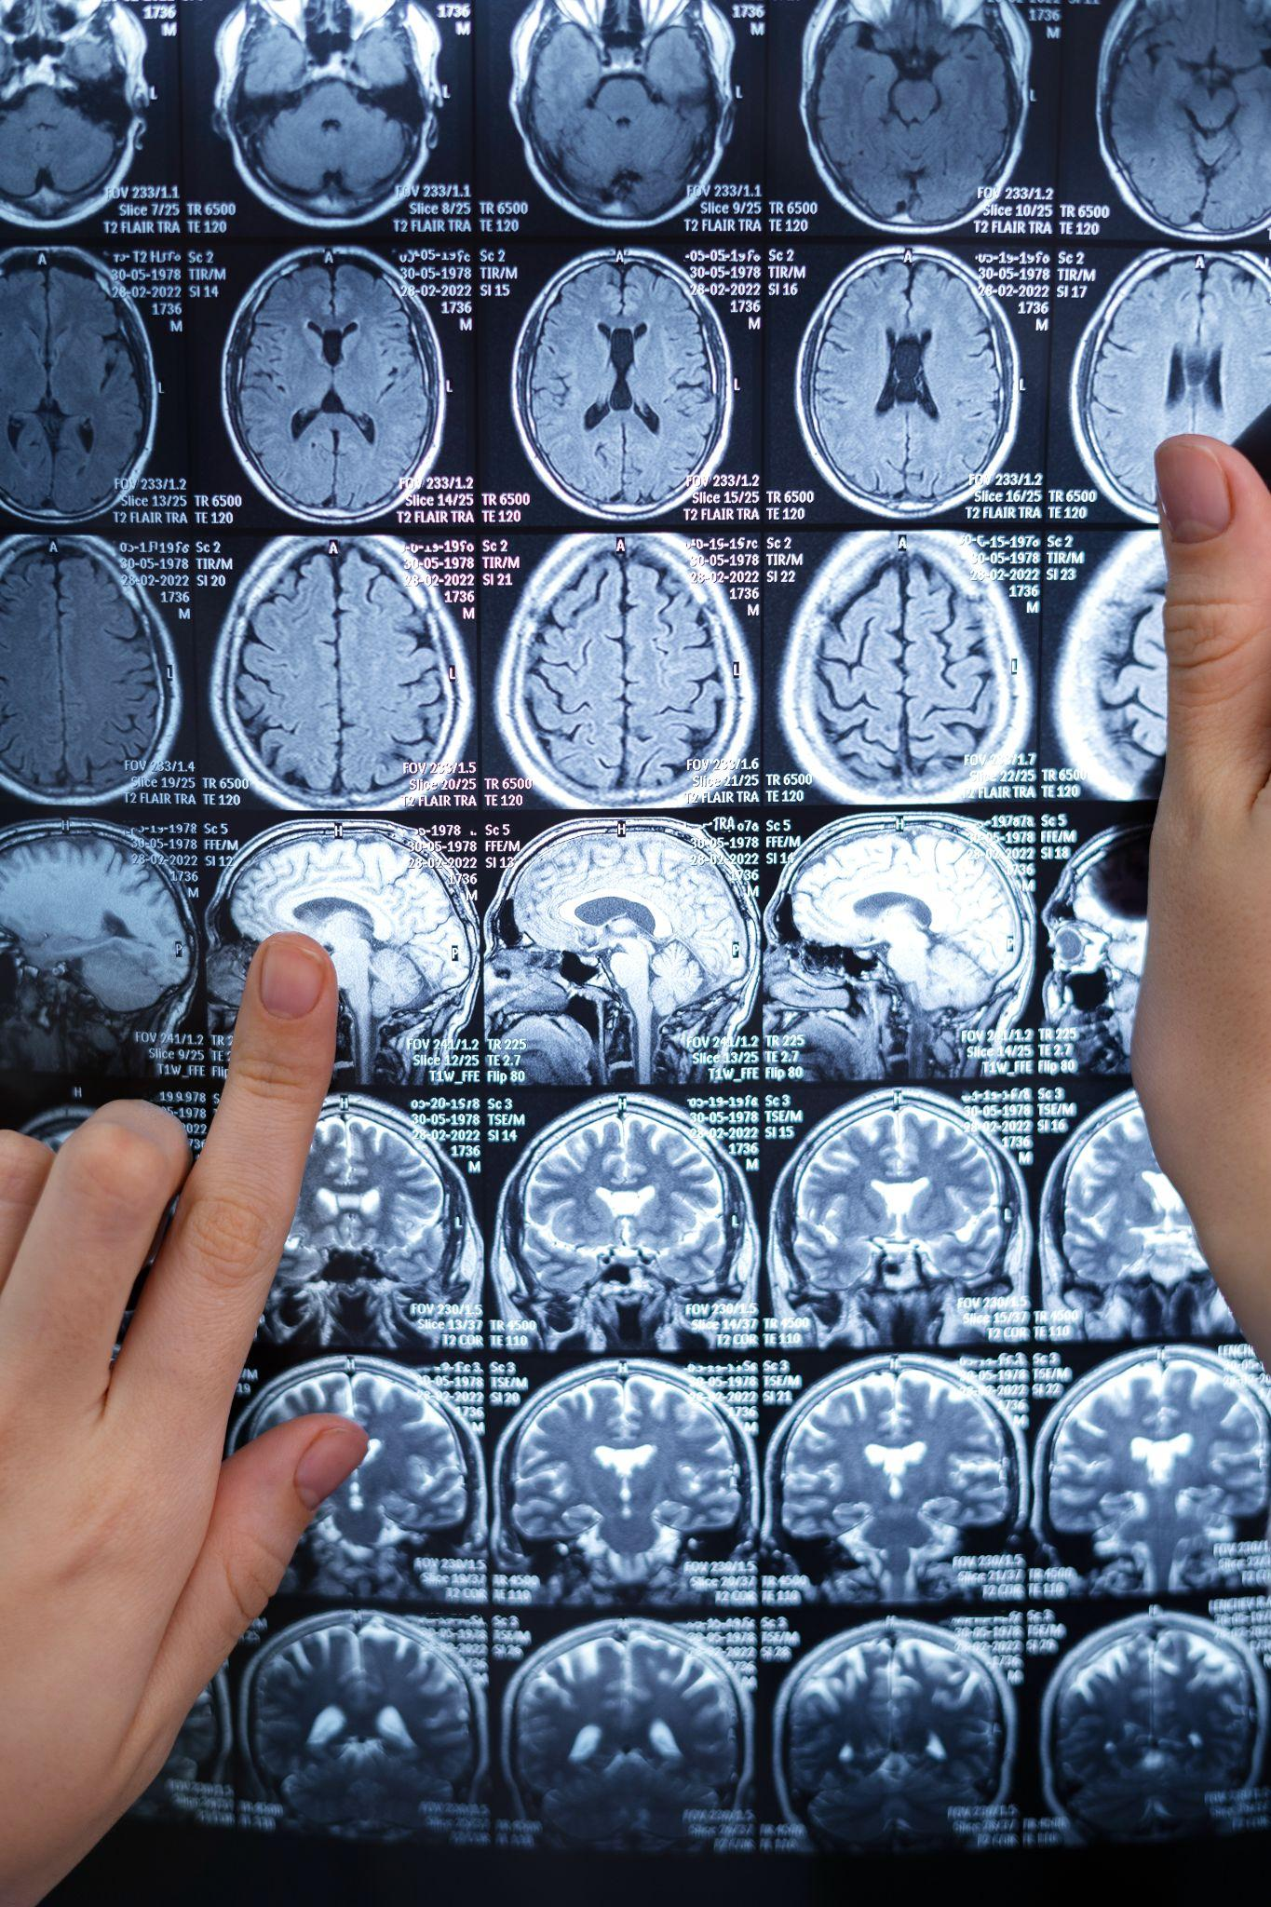
Conclusion
10
We were able to create and train a model that gave us very high accuracy on unseen data.
The project leverages advanced machine learning techniques for early brain tumor detection. It features a deep learning model implemented with Convolutional Neural Networks (CNNs) using TensorFlow and Keras. Emphasizing precision and sensitivity in analyzing medical images, the model excels in distinguishing between tumor and non-tumor images. The goal is to contribute significantly to early diagnosis of critical brain tumor conditions.

Slide 15


Thank You

